Slide 1


MOVIE DATA ANALYSIS
PRESENTED BY :
BHARATH SIMHA NAIDU M

Slide 2


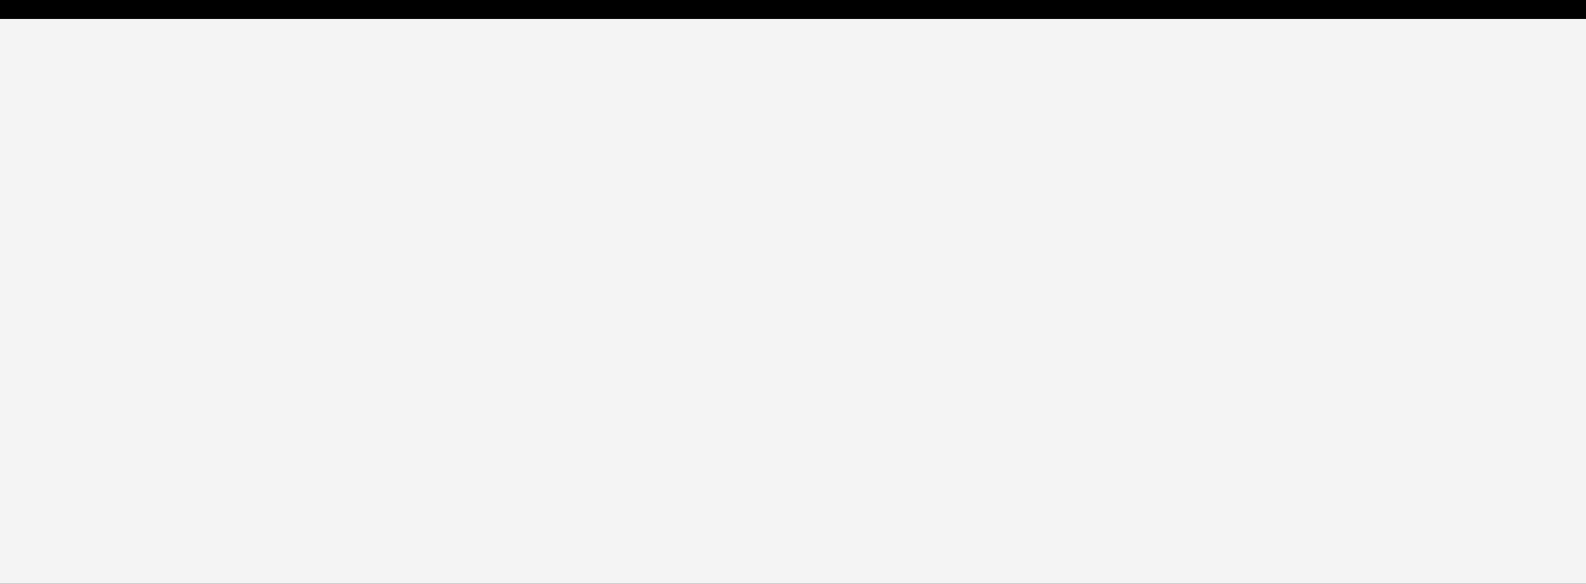
Agenda
PROBLEM STATEMENT | 3
DATA REQUIRMENTS | 4
DATA COLLECTION | 5
DATA VALIDATION | 6
DATA CLEANING | 7
TOOLS USED | 8
GRAPHS & INSIGHTS | 9
DASHBOARD | 10

Slide 3

PROBLEM STATEMENT
Enable filmmakers, producers, and marketers to identify key success factors, refine strategies, and make data-driven decisions for future movie projects.

Slide 4

BUDGET
COLLECTIONS
ACTORS RATING
NUM OF MULTIPLEXS
EXPENSES
PRODUCER RATING
DIRECTOR RATING
DATA REQUIRMENTS

Slide 5
Back to Agenda
DATA COLLECTION
Primary data given by examiner.

Slide 6
DATA VALIDATION
Data which I got is valid.
No validation required.

Slide 7

No data cleaning required as i got the clean data from reliable source.
DATA CLEANING
If required we can use these tools :
python
SQL
tableau
power BI

Slide 8
Tableau was the tool that im using to analyse this data.
TOOLS USED

Slide 9

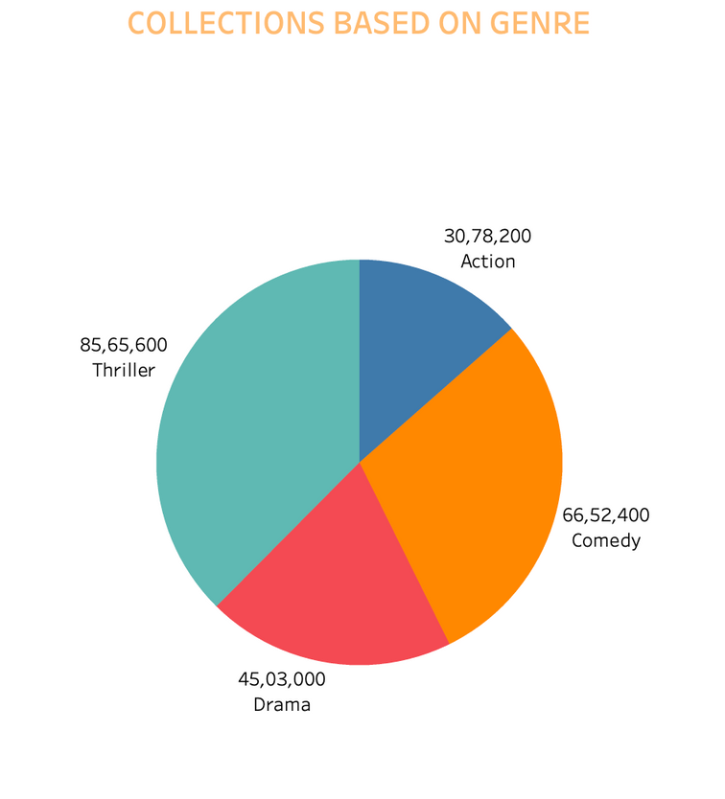
COLLECTIONS BASED ON GENRE
Insight:
Action movies have the highest collections (₹85.65M), followed by Comedy (₹66.52M). Drama and Thriller genres have comparatively lower collections at ₹45.03M and ₹30.78M, respectively.
Actionable Insight:
Action and Comedy movies are the most lucrative genres, suggesting these should be the focus for higher box office revenue.

Slide 10
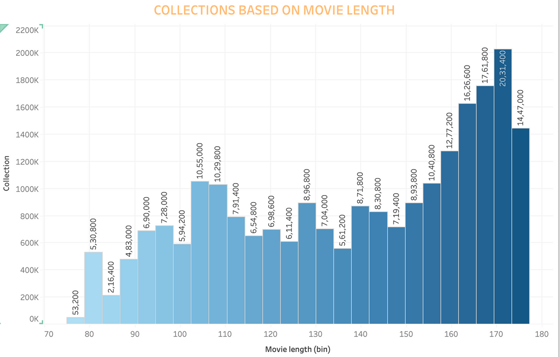
COLLECTIONS BASED ON MOVIE LENGTH
Back to Agenda
Insight:
Movies with a length of 160-180 minutes generate the highest collections (₹2M), while shorter movies (80-120 minutes) show significantly lower collections (₹0.72M to ₹1.05M).
Actionable Insight:
Longer movies (160+ minutes) seem to perform better in terms of collections, indicating that audiences prefer more comprehensive storytelling.

Slide 11
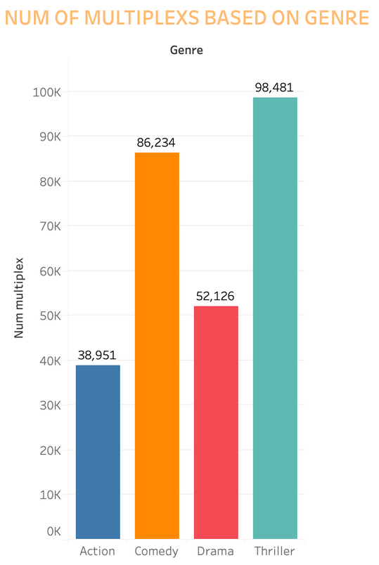
NUM OF MULTIPLEXS BASED ON GENRE
Back to Agenda
Insight:
Thriller movies are screened in the most multiplexes (98,481), followed by Comedy (86,234) and Drama (52,126). Action movies are screened in the least number of multiplexes (38,951).
Actionable Insight:
Thrillers have the highest availability, suggesting strong demand or preference from multiplexes. Action movies may require more multiplex tie-ups to increase visibility.

Slide 12
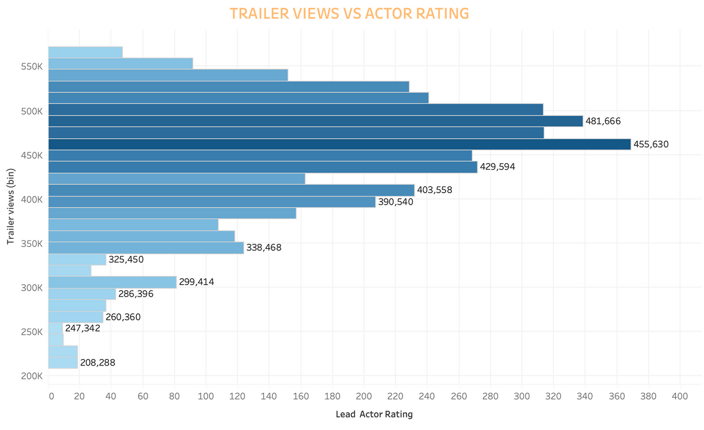
TRAILER VIEWS VS ACTOR RATING
Back to Agenda
Insight:
Higher lead actor ratings are associated with more trailer views. For example, actors with ratings above 400 generate ~455K trailer views, whereas actors with ratings below 300 generate ~260K views or less.
Actionable Insight:
Casting high-rated actors not only boosts trailer engagement but potentially improves movie visibility and interest.

Slide 13
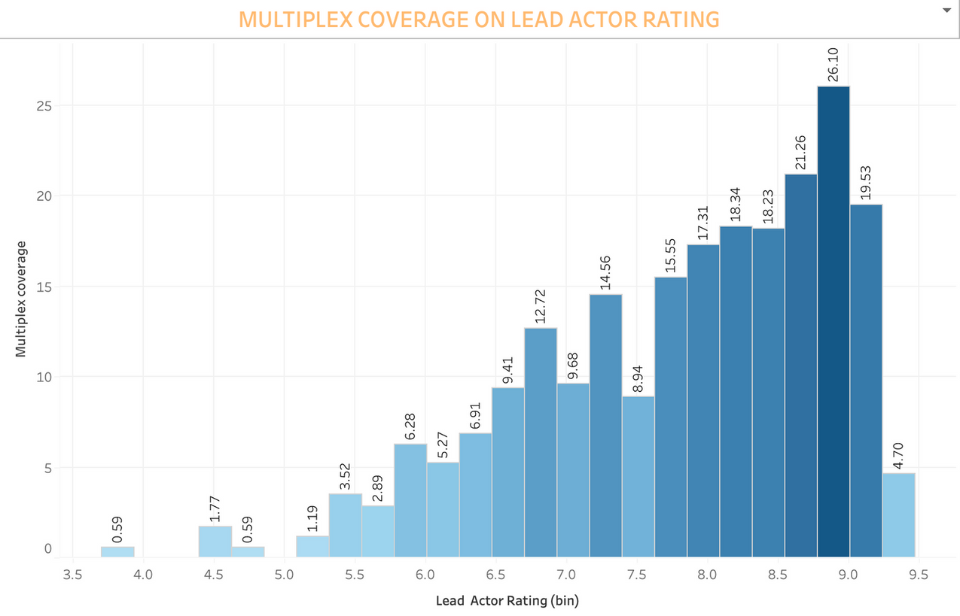
MULTIPLEX COVERAGE ON ACTOR RATING
Back to Agenda
Insight:
Movies with lead actors rated between 8-9 have the highest multiplex coverage (18.34), while movies with actors rated below 5 have the lowest coverage (0.59).
Actionable Insight:
Multiplexes prioritize movies with well-rated lead actors. This highlights the importance of casting highly-rated actors to secure better screening coverage.

Slide 14
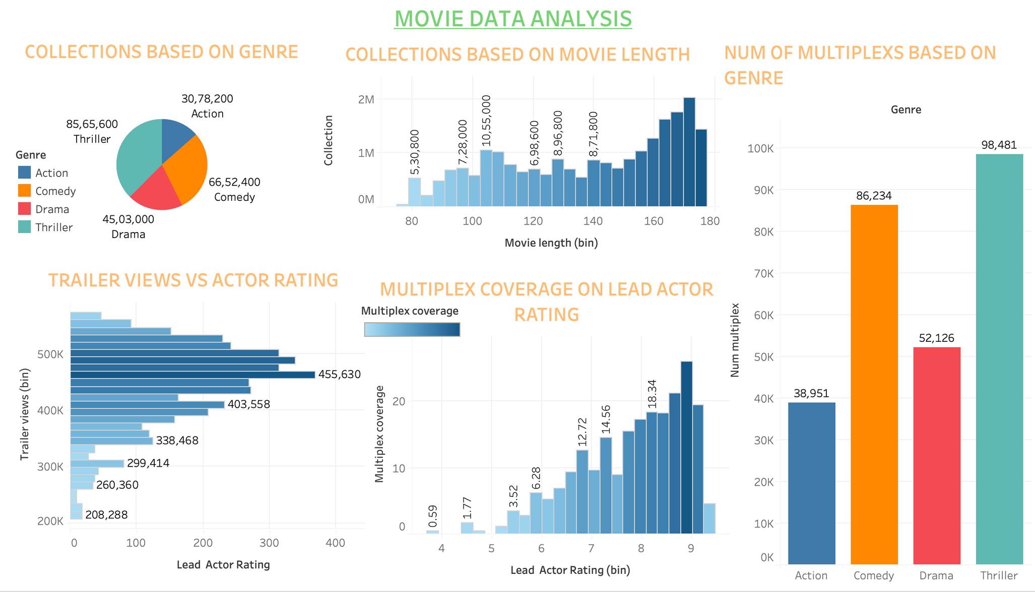
DASHBOARD:

